Slide 1
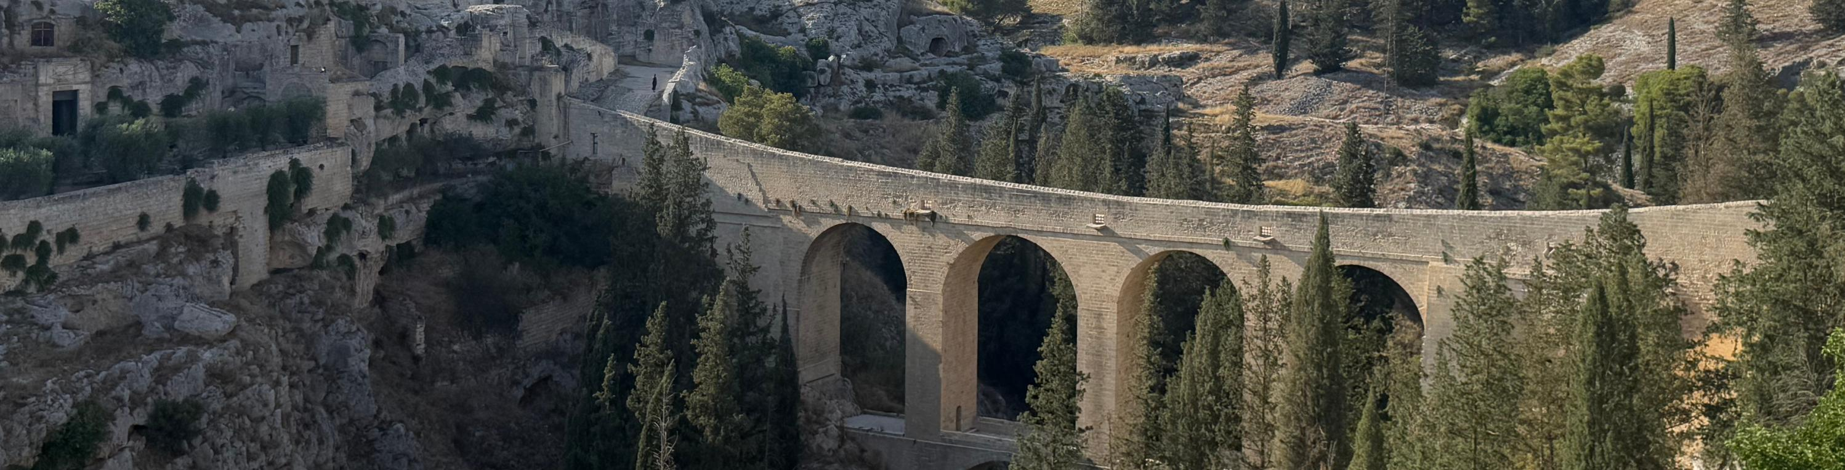
“Italo Ladisa” Apulia Youth Camp
Veronika Lukyanenko
Italy—Apulia
MY EXPERIENCE IN THE LIONS YOUTH EXCHANGE PROGRAM 2025

Slide 2
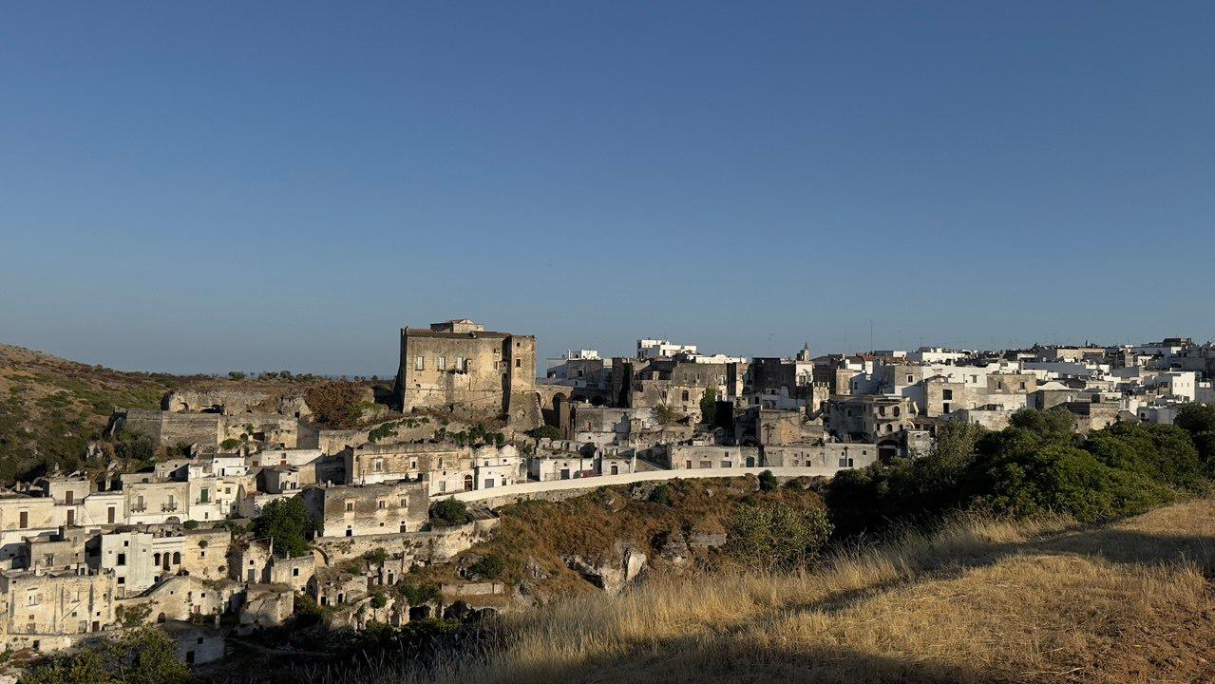
Owerview/Table of Contents
  General Information
  My Host Families
  Camp Week
  What I Learned & Conclusion

Slide 3
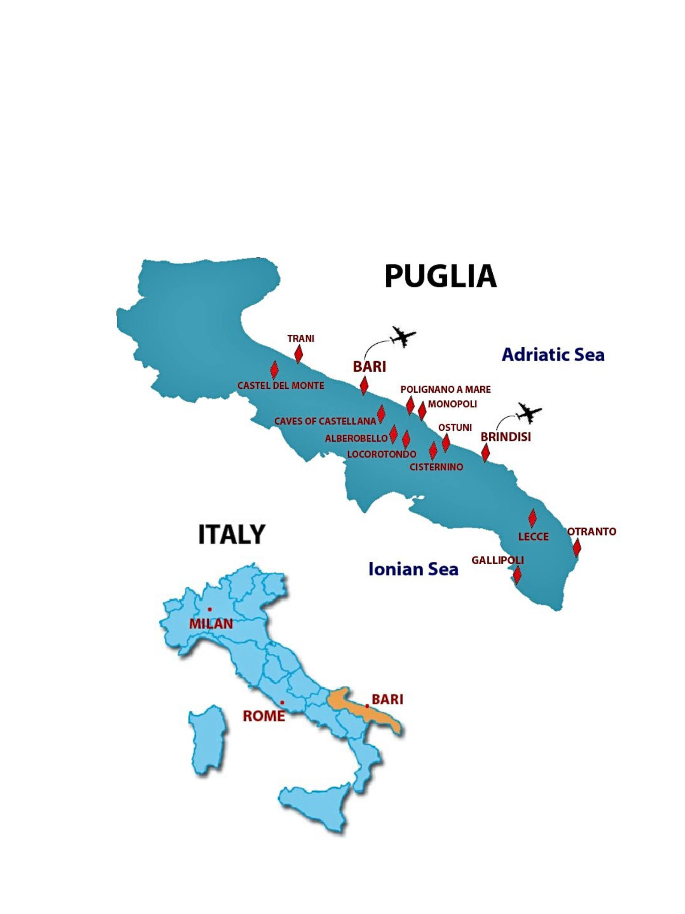
General Information
  Location: Southern Italy – “heel of the boot”
  Surrounded by Adriatic & Ionian Seas
  Climate: hot and sunny in summer
  Program duration: 3 weeks
Week 1: Host Family 1
Week 2: Host Family 2
Week 3: International Camp

Slide 4
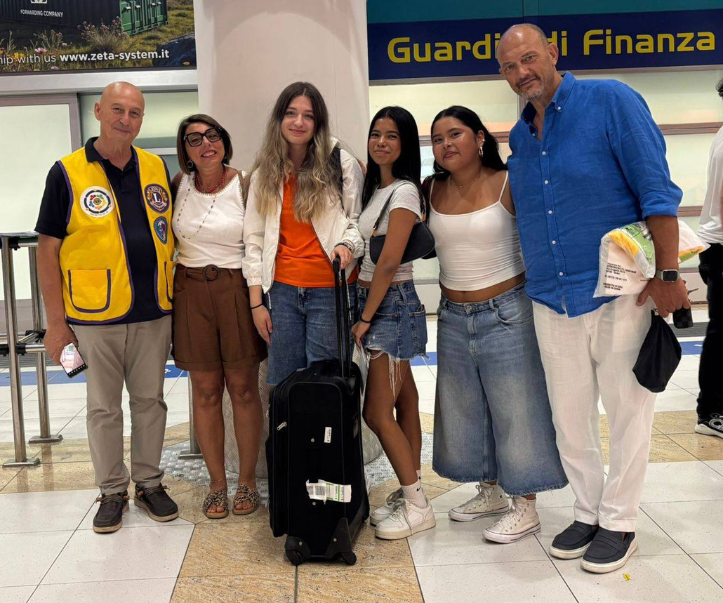
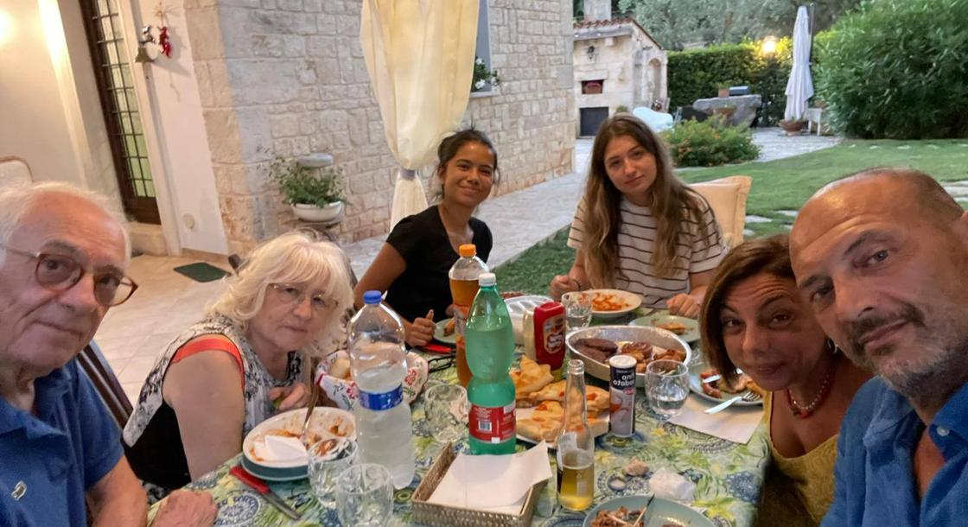
My First Host Family
Members
  Host mother–Daniela
  Host father–Giuseppe
  First daughter–Saira Tatiana
  Second daughter–Paula Alejandra
  Grandmother–Matilde
  Grandfather–Giovanni
  4 cats–Emmicia, Gigi, Marvel and Dora

Slide 5
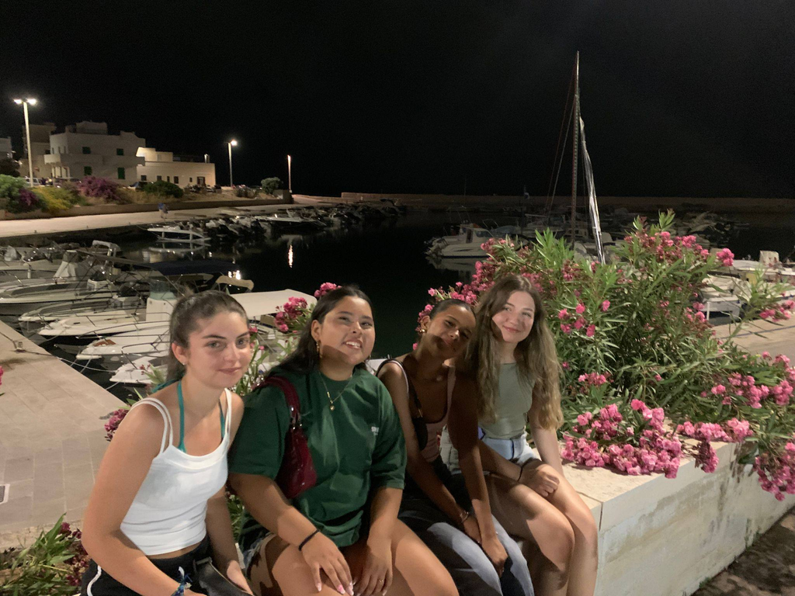
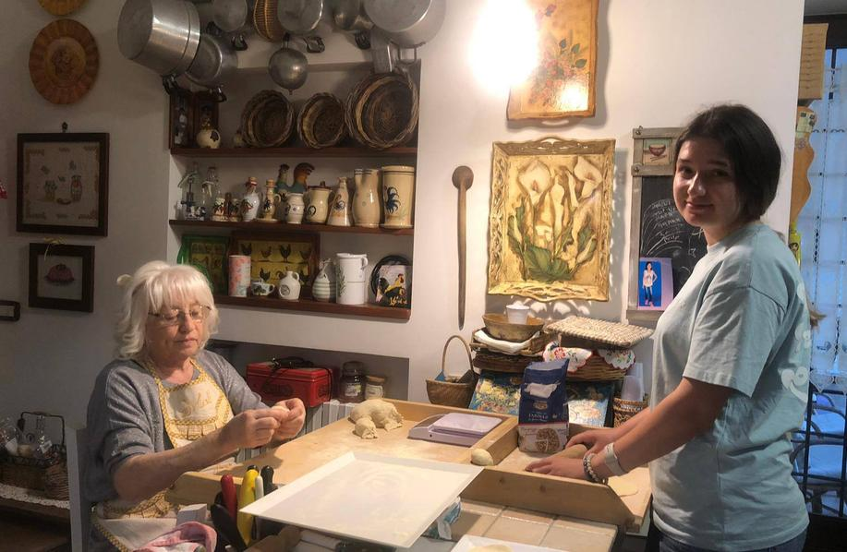
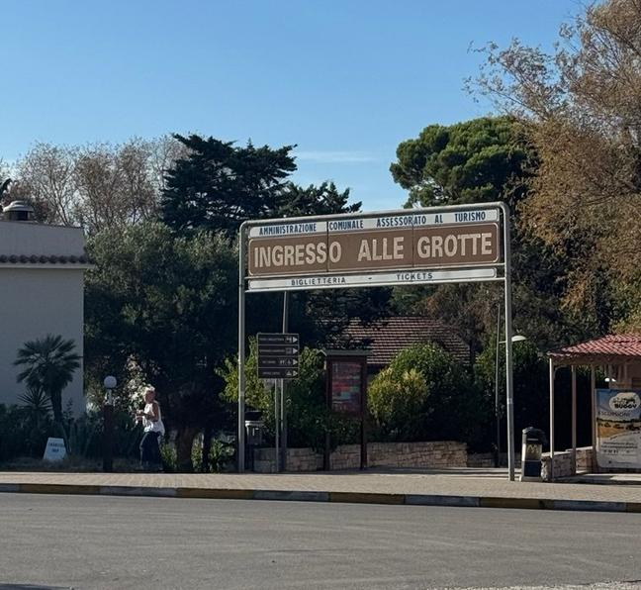

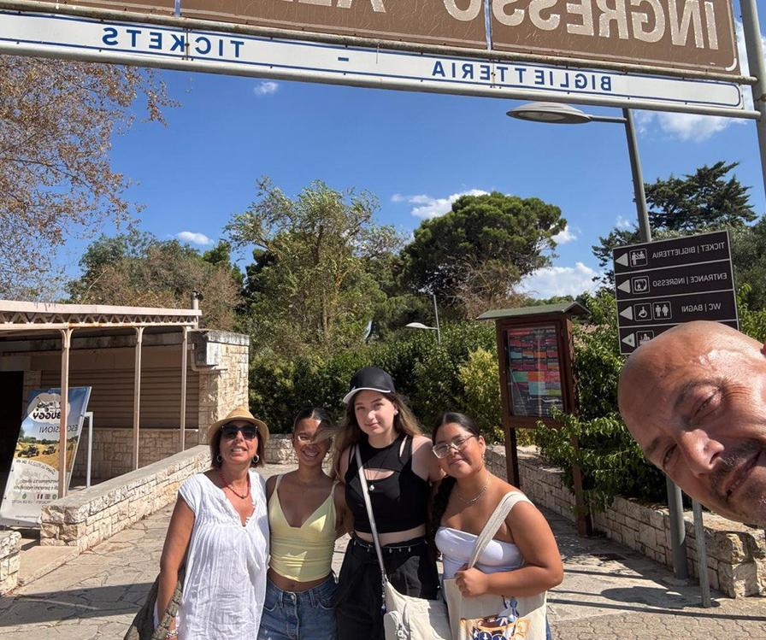
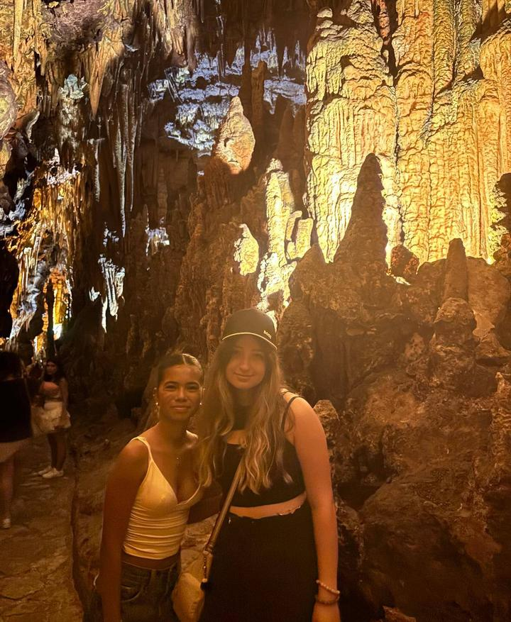
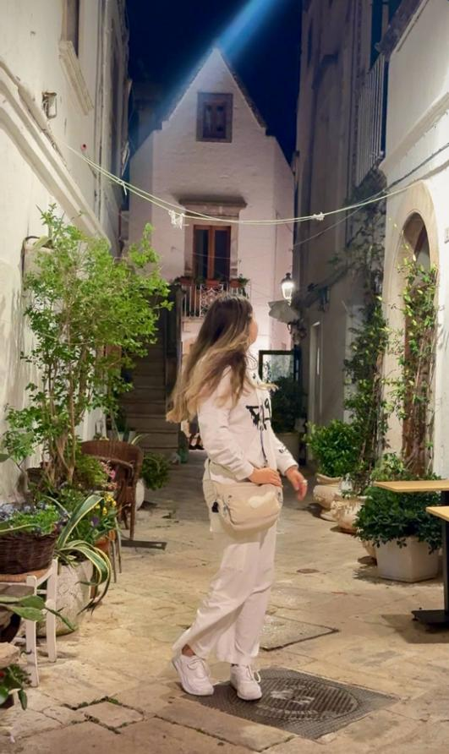
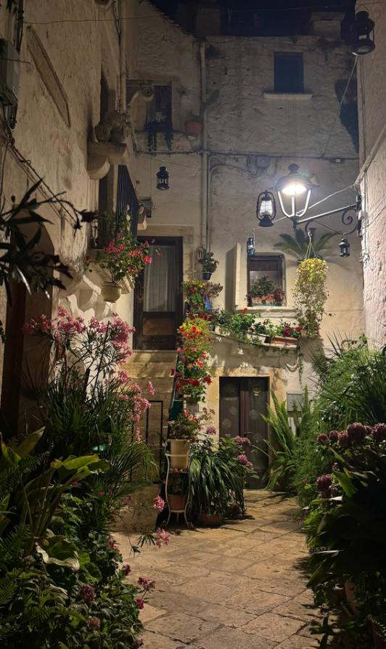

Fasano
My First Host Family
Activities
Locorotondo
Castellana Caves

Slide 6
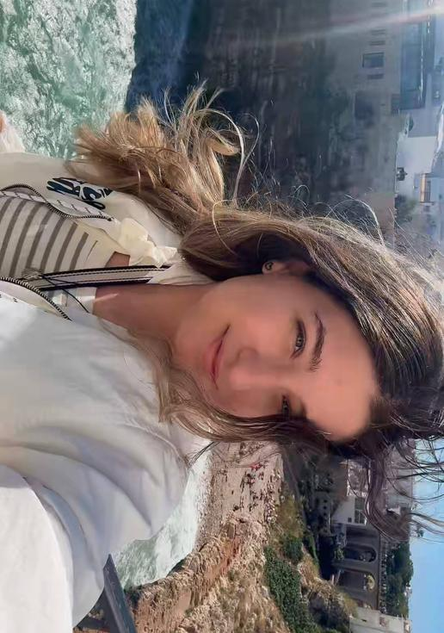
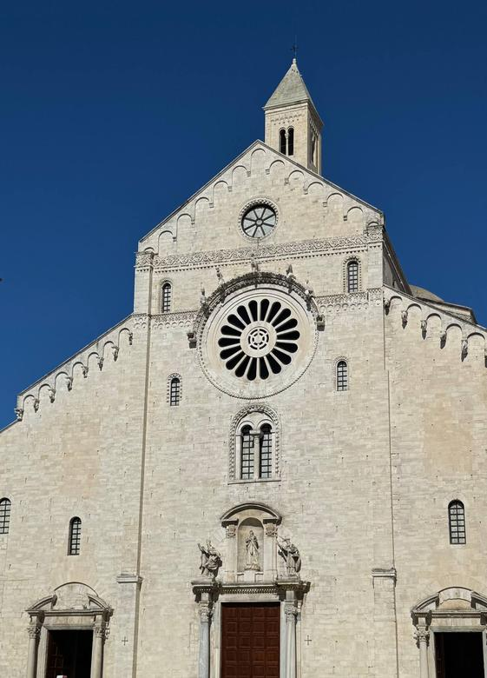
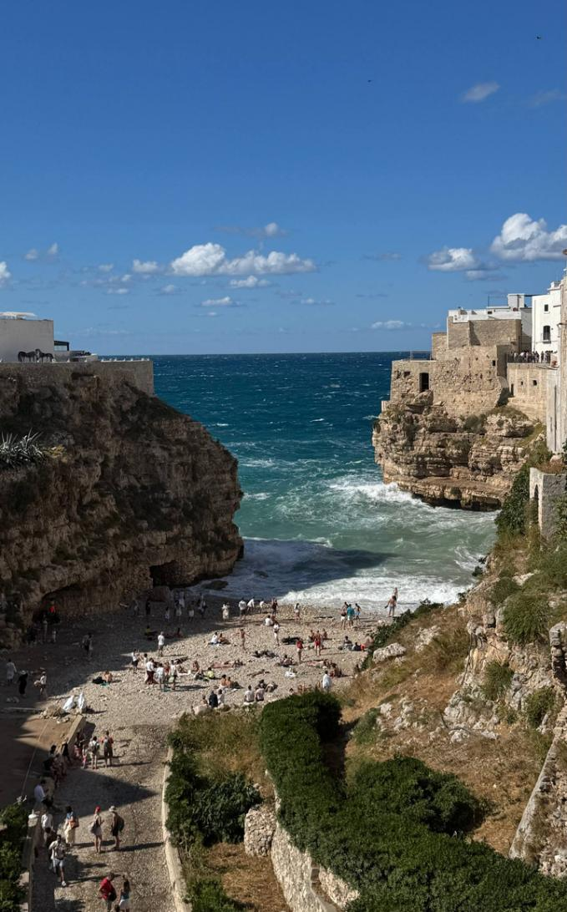
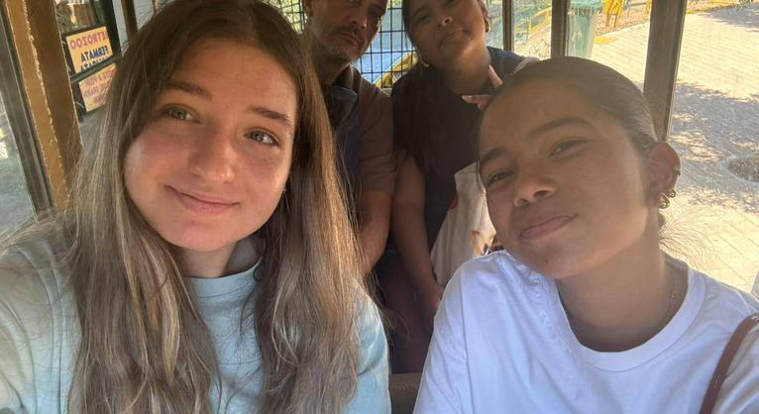

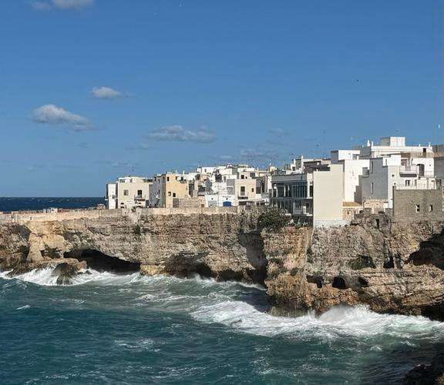
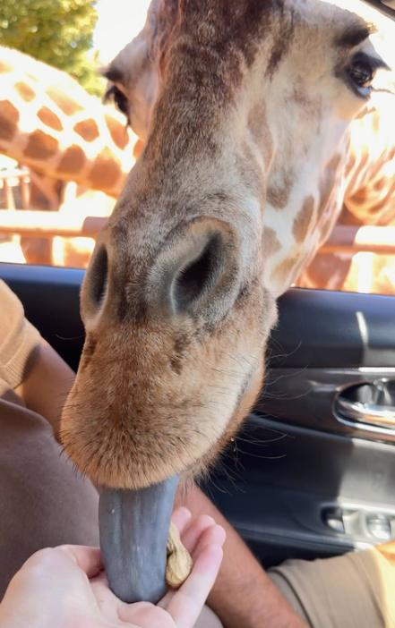
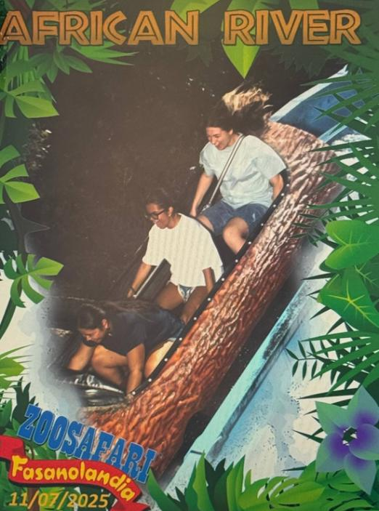
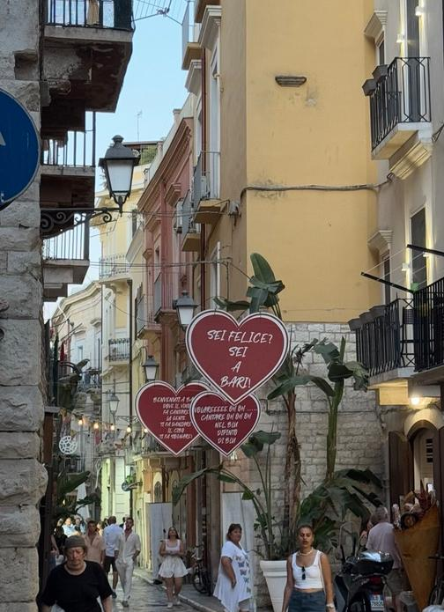

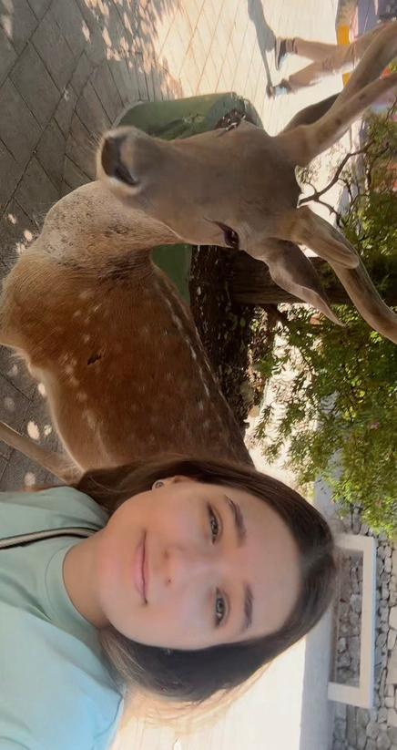
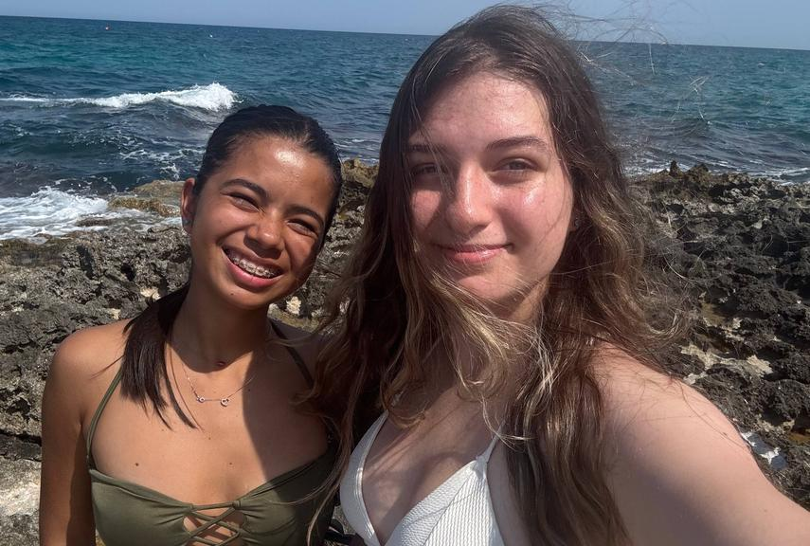
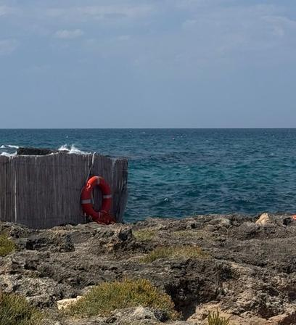
Bari
Zoosafari Fasano
Polignano a Mare

Slide 7
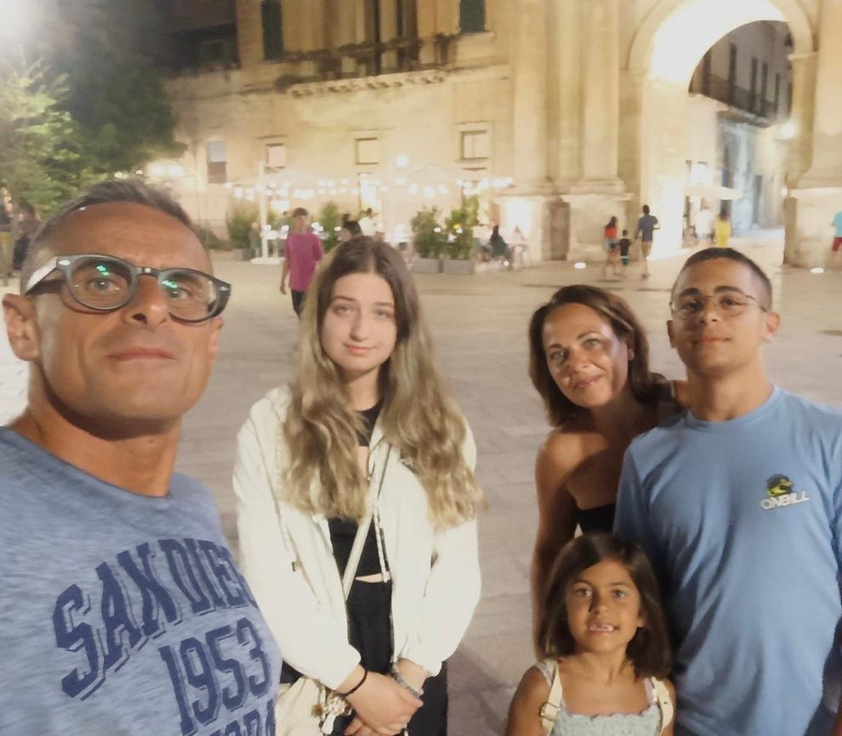
My Second Host Family
Members
  Host mother–Suela
  Host father–Vitantonio
  Their son–Riccardo
  Their daughter–Virginia

Slide 8
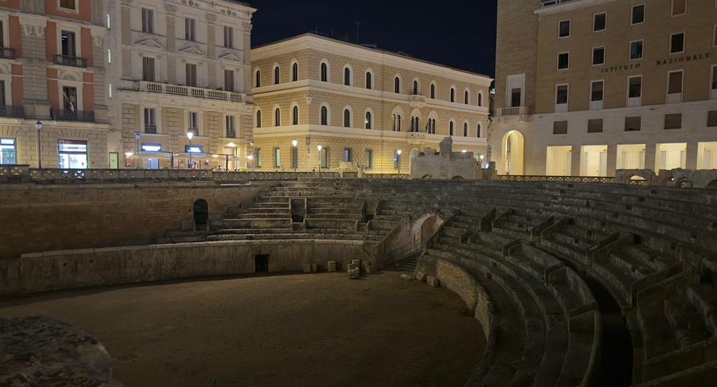
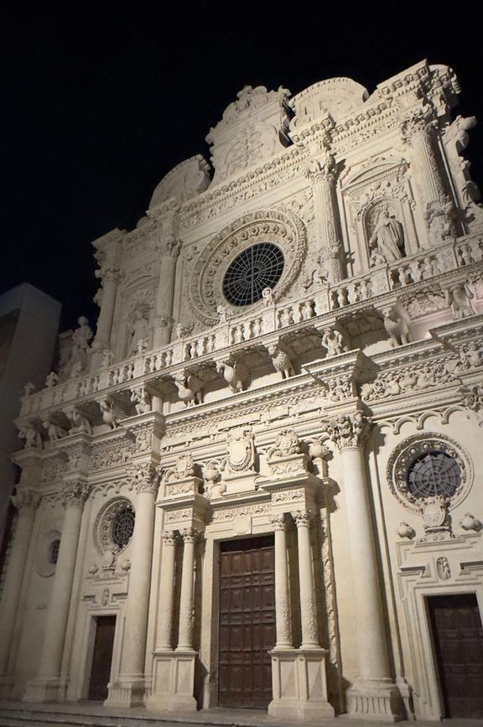
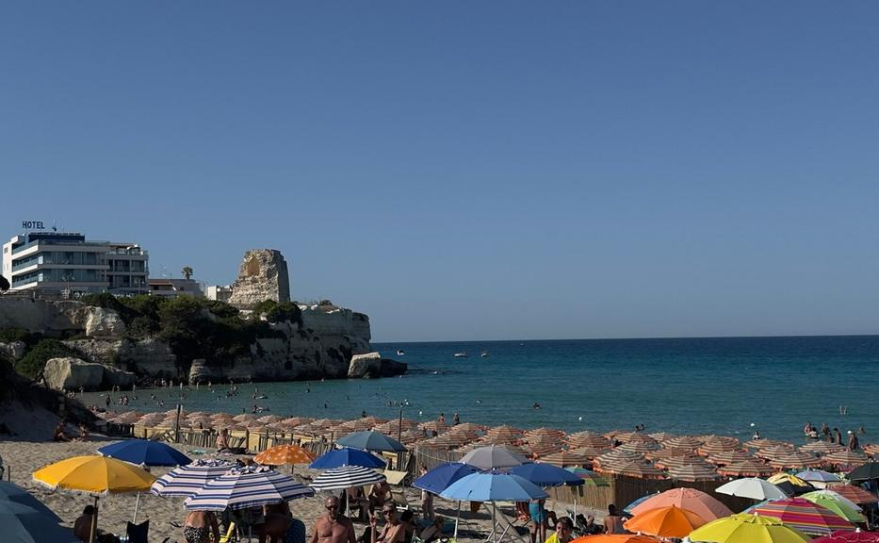
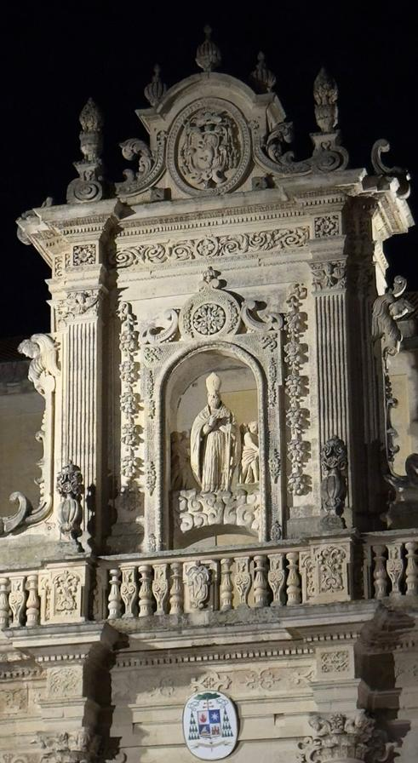
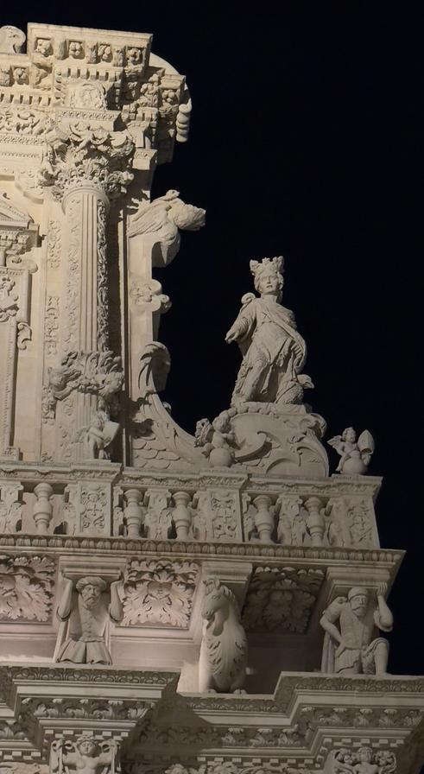
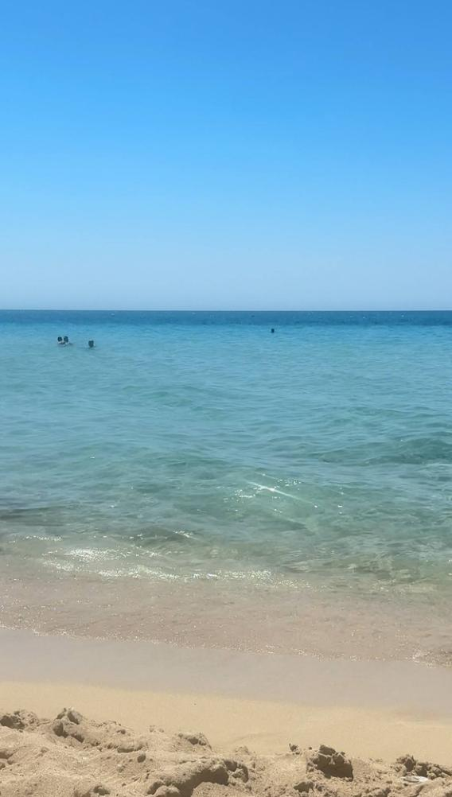
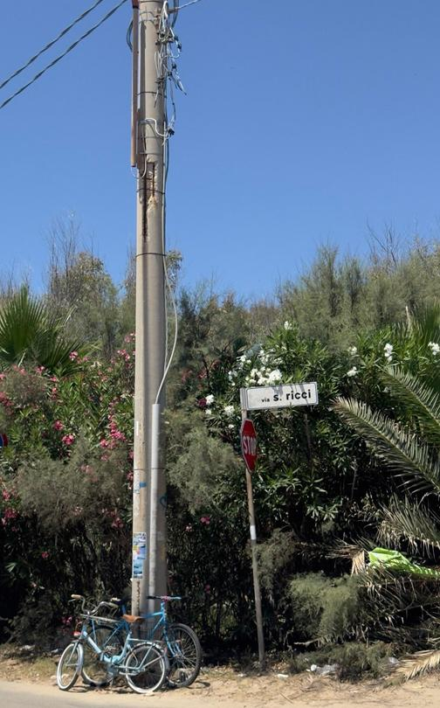
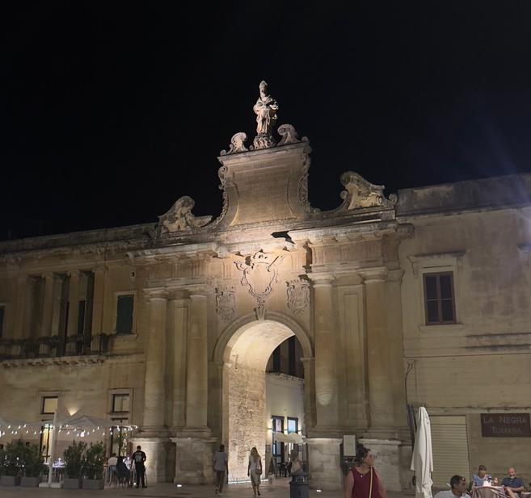
Torre dell'Orso
My Second Host Family
Activities
Lecce
Lido Marini

Slide 9
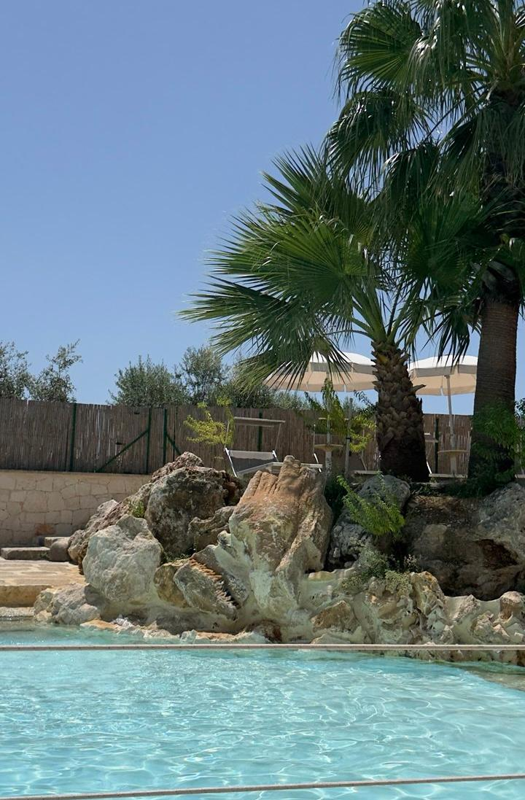
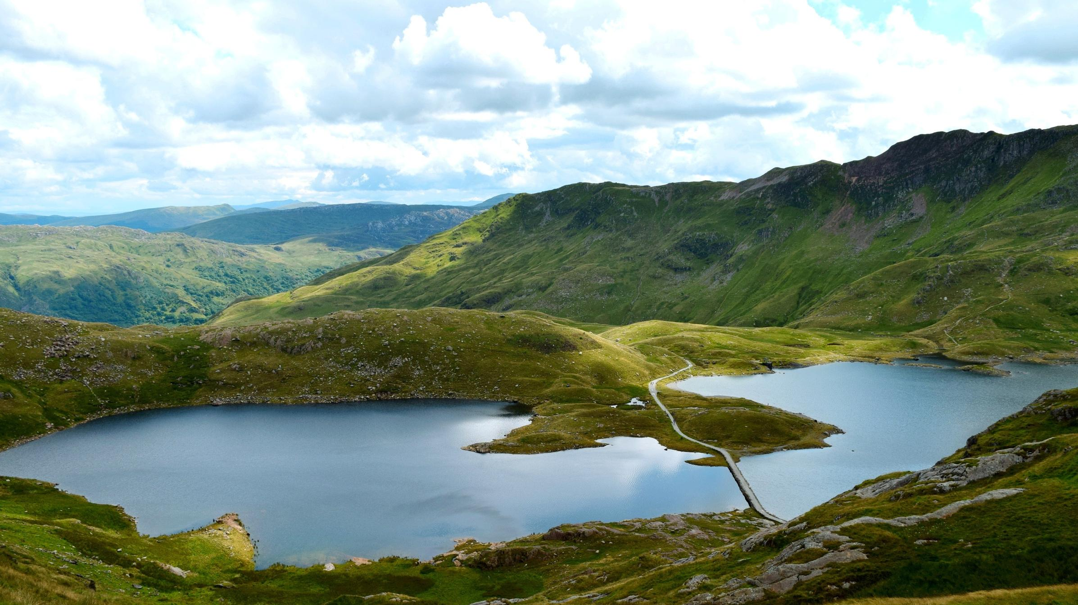
Camp Overview
  Location: Masseria Delprete, Apulia
  Accommodation in hotel with pool
  Participants from many countries
  Welcome dinner & country presentations
  Mix of excursions, culture, and fun events
Camp Week

Slide 10
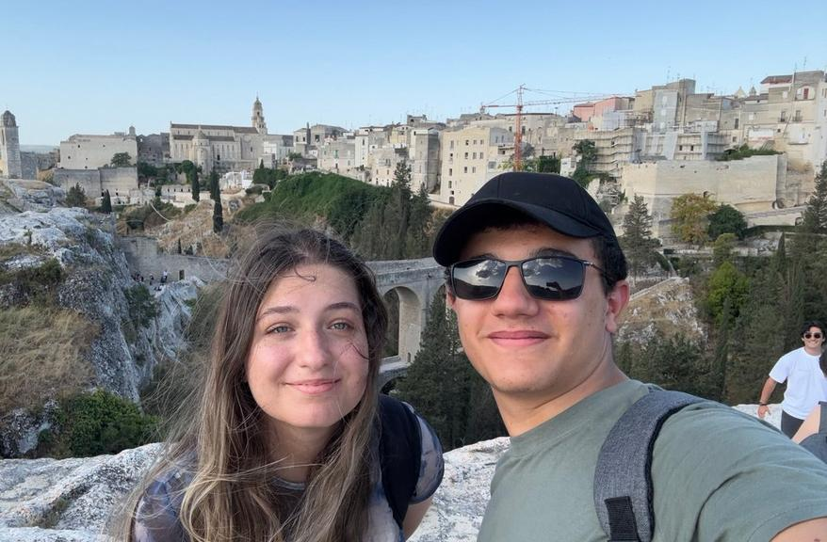
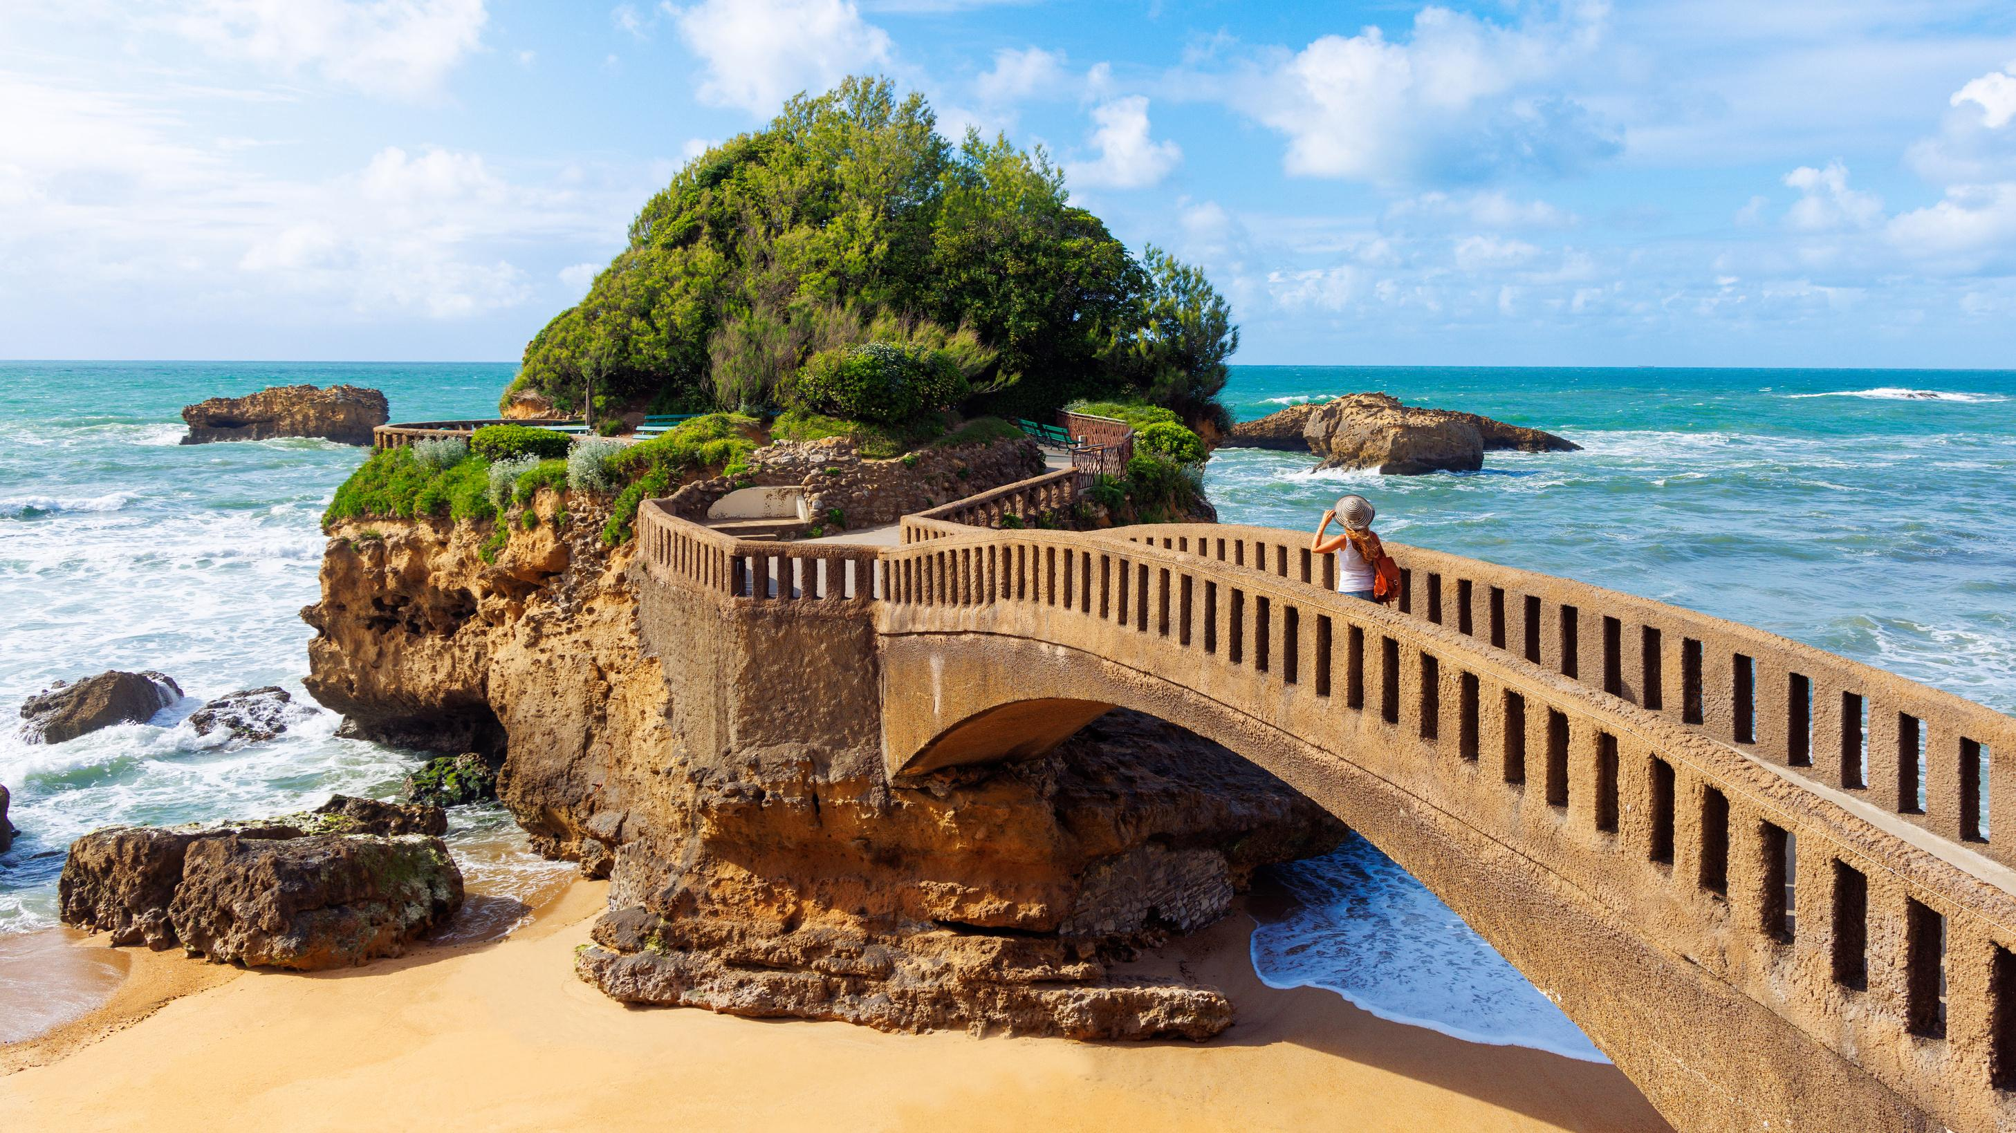
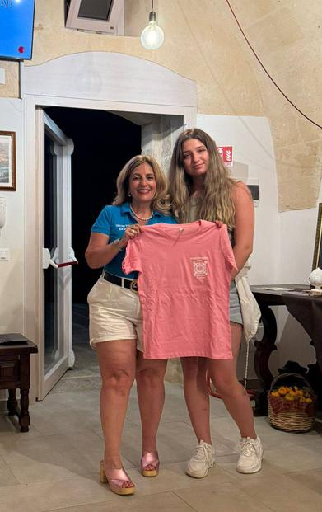
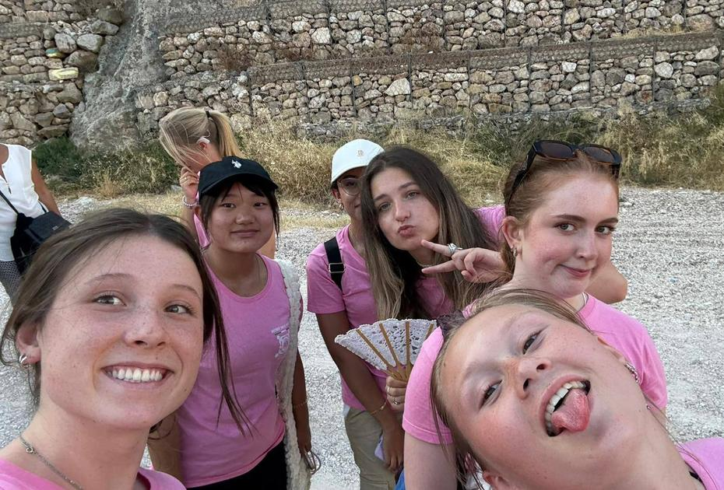
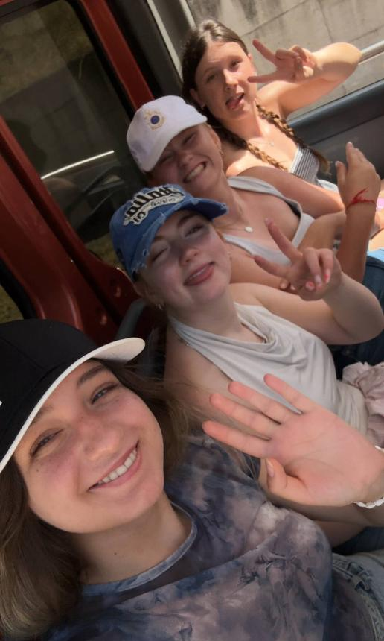
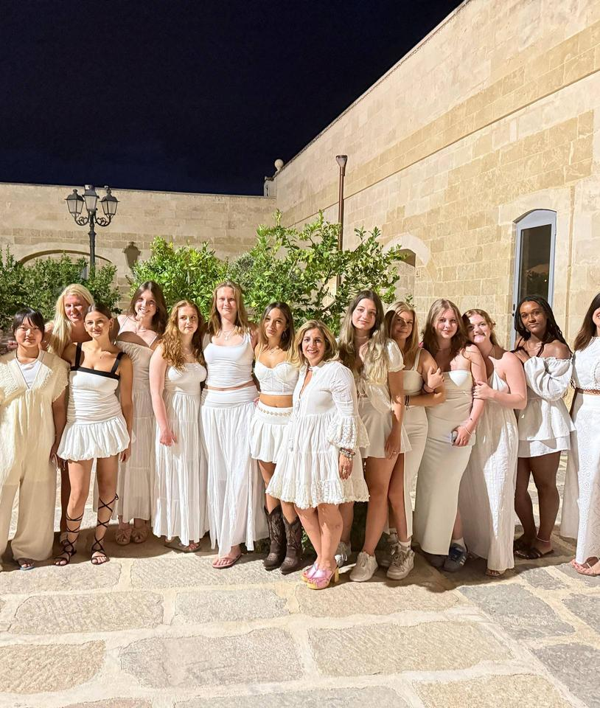
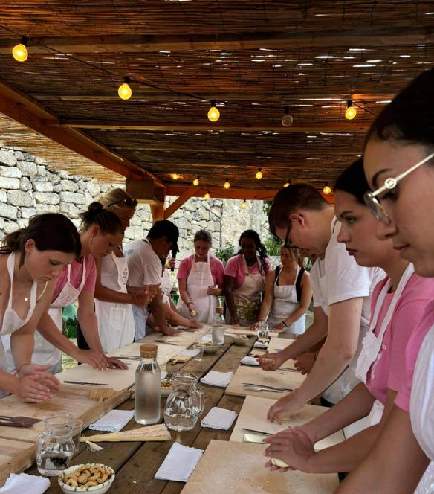
Activities & Trips
• City visits: Taranto, Gioia del Colle, Alberobello, Castellaneta, Ginosa, Matera, Gravina, Barletta, Castel del Monte
• Free time at hotel & pool
• Themed parties (White Party, Waikiki Party)
• Gala dinner & closing ceremony

Slide 11
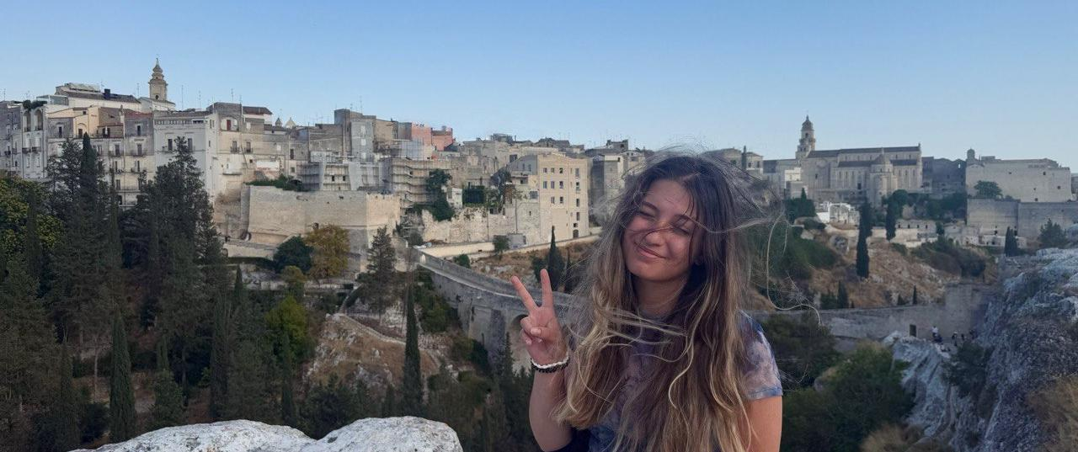
What I Take With Me
  First time in Italy – unforgettable experience
  Grateful to host families for kindness & warmth
  Thankful to camp leaders for their energy & support
  Made wonderful international friends
  Memories I will keep forever

Slide 12
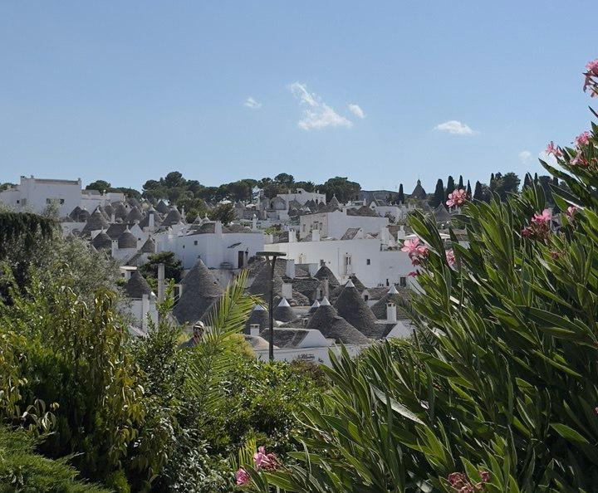
THE END
Thanks to the Lions Club for this wonderful experience!

